Slide 1
Annual Interagency Accessibility Forum
Accessibility: A Foundation for Inclusion, Diversity, and Equity
October 12-14, 2021
Inclusive Apprenticeships and Career Pathways
Scott Michael Robertson, Ph.D. and Josh Christianson, M.S.

Slide 2
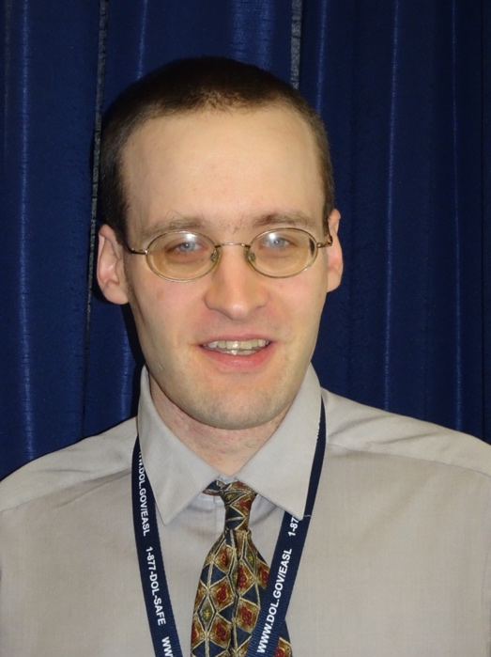

The Session’s Presenters Have These Backgrounds
Scott Michael Robertson, Ph.D.
Senior Policy Advisor, Office of Disability Employment Policy
U.S. Department of Labor
Federal Project Manager, Partnership on Inclusive Apprenticeship
Pronouns: He, Him, His
Josh Christianson, M.S.
Senior Consultant, Wheelhouse Group
Project Director, Partnership on Inclusive Apprenticeship
Pronouns: He, Him, His

Slide 3


Office of Disability Employment Policy Has This Mission
ODEP's mission is to develop and influence policies and practices that increase the number and quality of employment opportunities for people with disabilities.
dol.gov/agencies/odep

Slide 4



ODEP’s Key Initiatives Include…
Partnership on Inclusive Apprenticeship (PIA) www.inclusiveapprenticeship.org
Partnership on Employment & Accessible Technology (PEAT) www.peatworks.org
Job Accommodation Network (JAN) www.askjan.org
EARN (Employer Assistance and Resource Network on Disability Inclusion) www.askearn.org

Slide 5


Spotlighting National Disability Employment Awareness Month
Annual commemoration and campaign held in October
2021 theme of “America’s Recovery: Powered by Inclusion”
Resources for employers, policymakers, service providers, and others here: dol.gov/agencies/odep/initiatives/ndeam

Slide 6
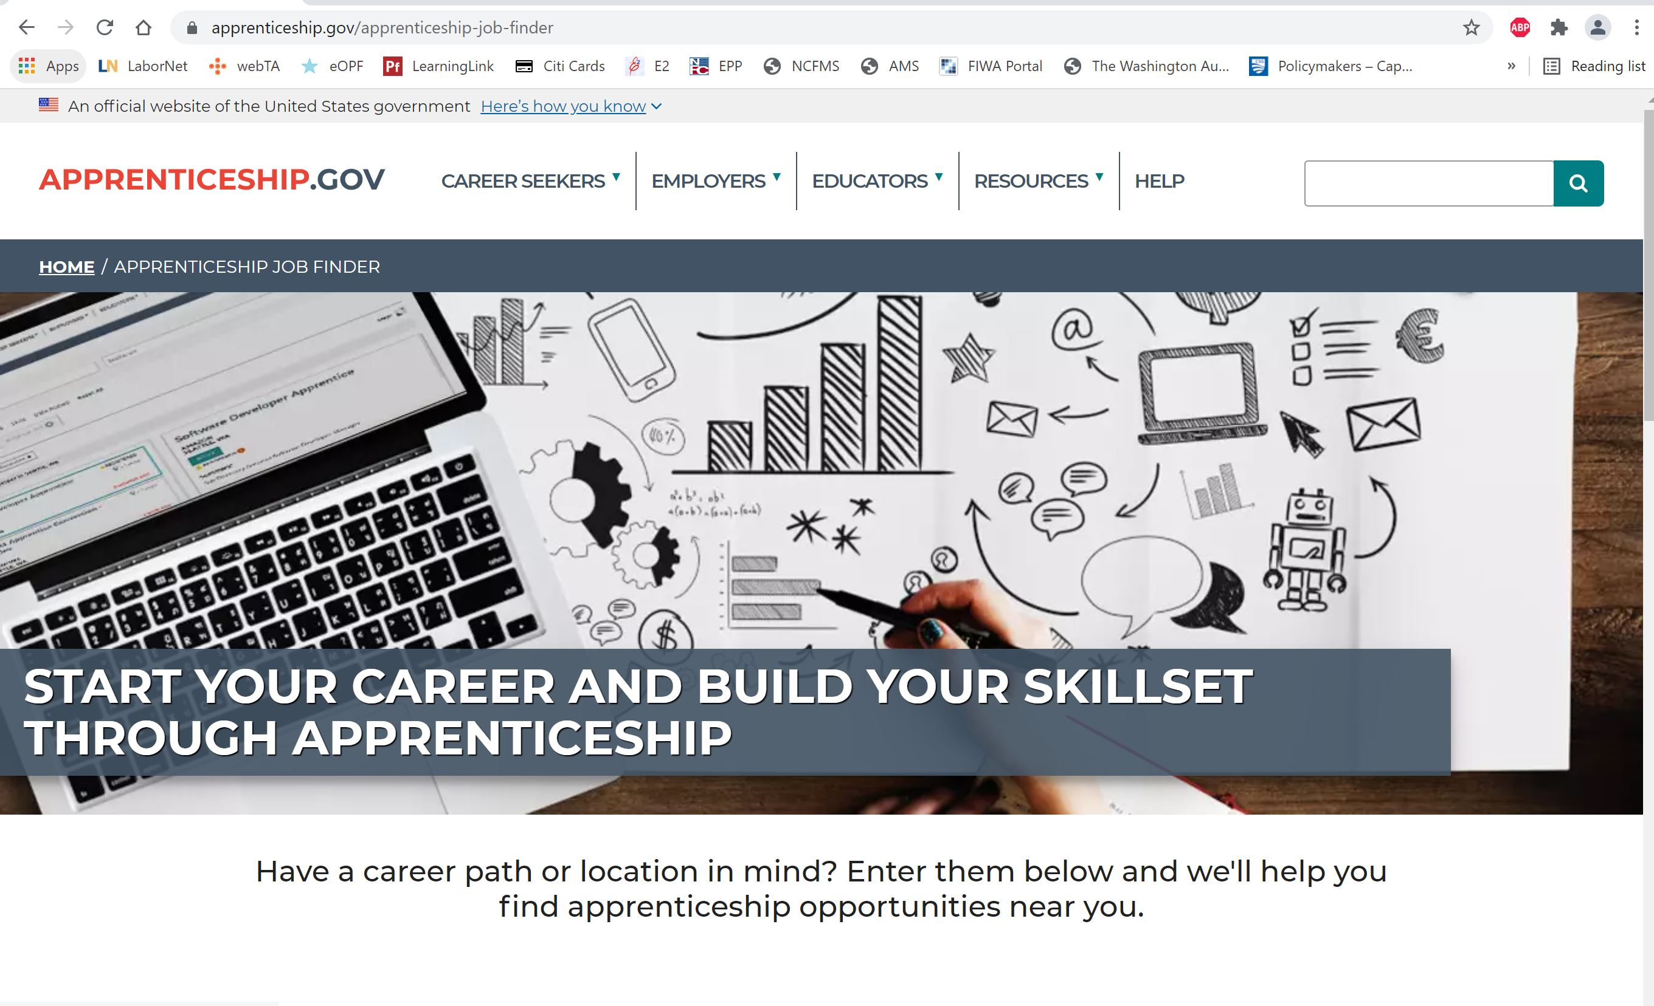
Apprenticeship Offers a Pathway to Gainful Employment
On-the-job training (OJT) plus related technical instruction (RTI)
Traineeship with gainful wages and credentialing (e.g., certifications, degrees, etc.)
Alignment with varied skills, talents, supports, and accommodations
National Registered Apprenticeship system with about 625,000 career seekers
www.apprenticeship.gov: DOL’s one-stop resource website on apprenticeships

Slide 7
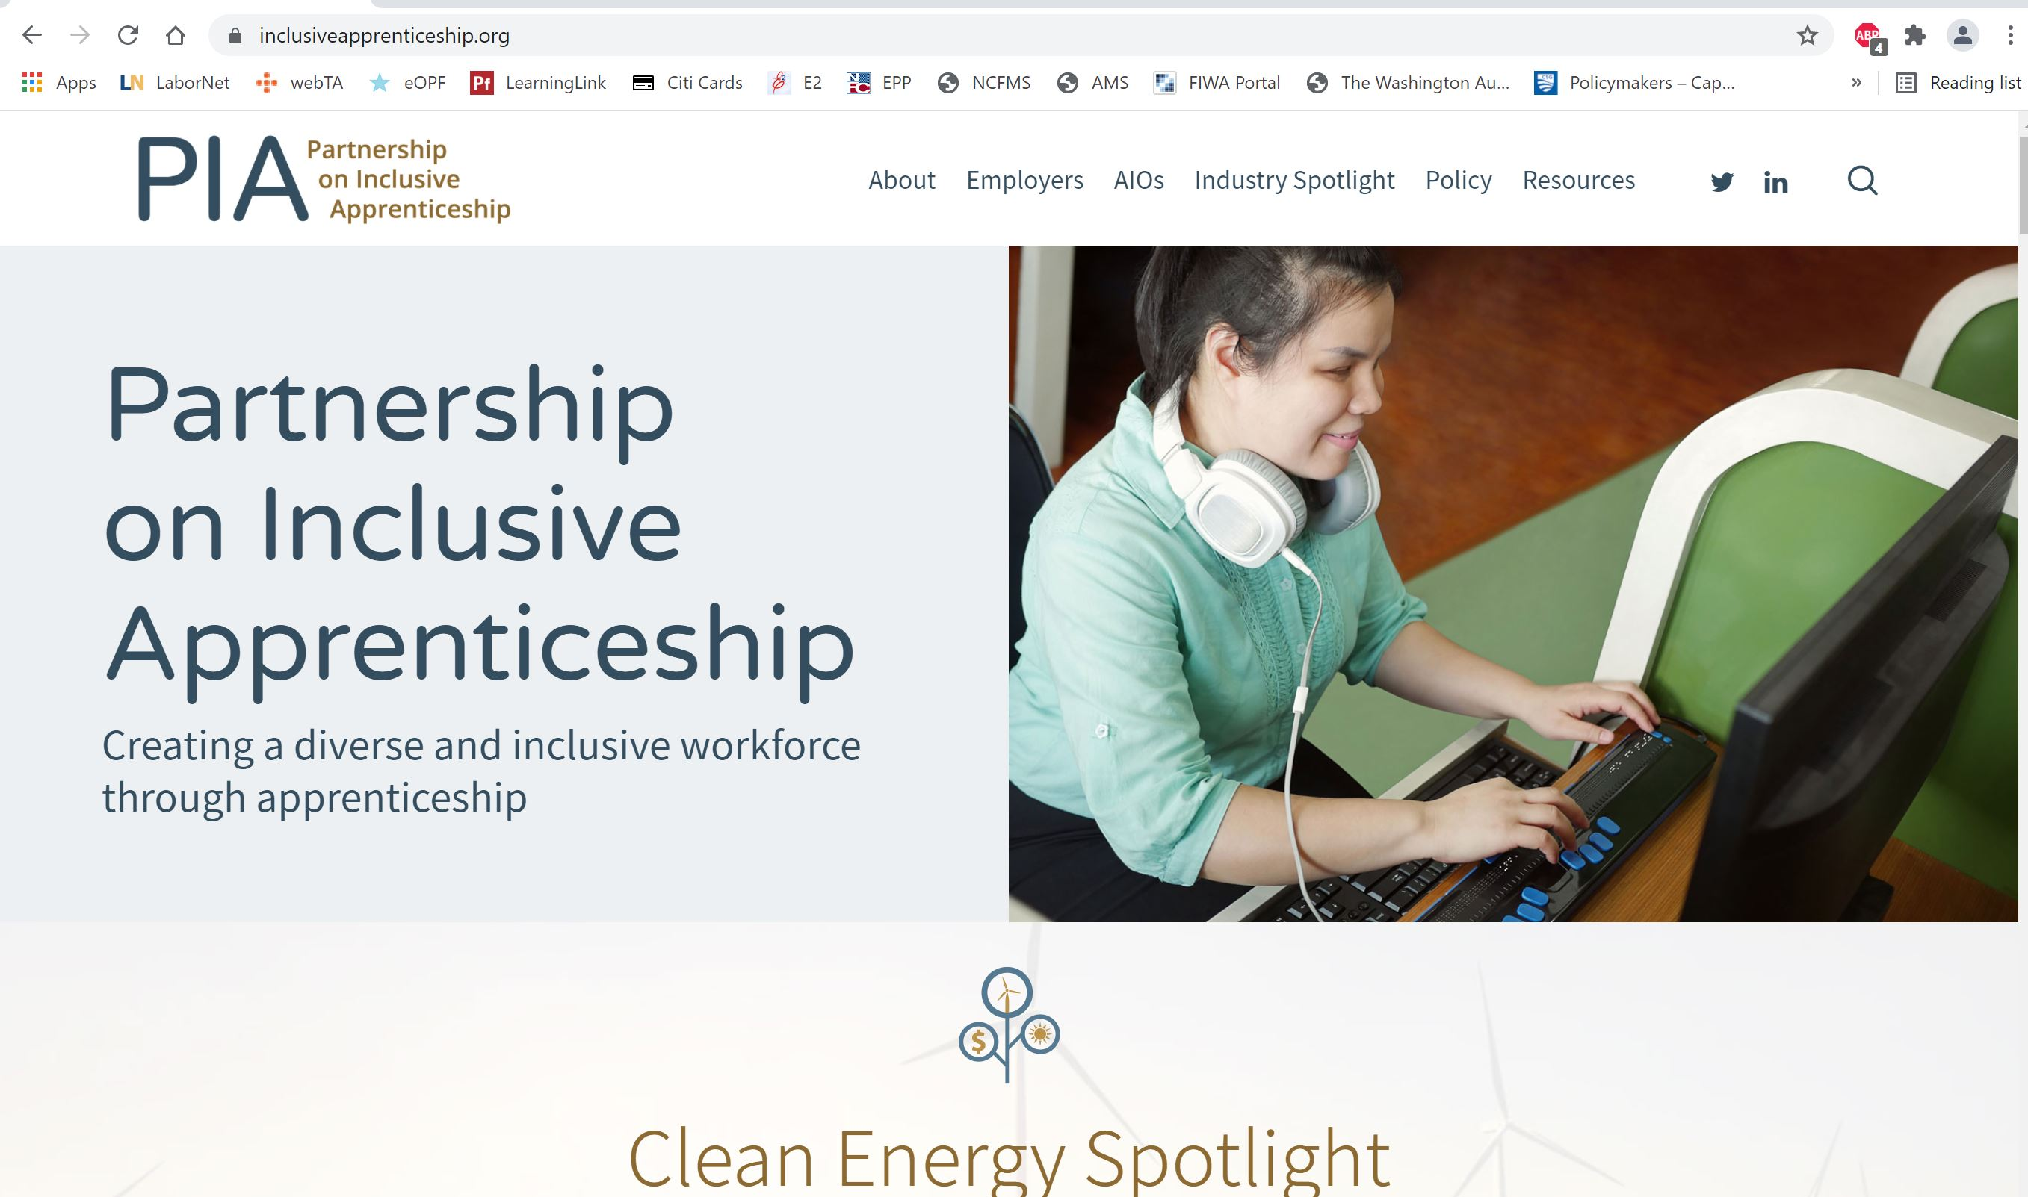



PIA Drives Inclusive Career Pathways through Apprenticeship
Project launched in FY2021 (Oct. 2020) and funded at $3.8 million for the first 2 yrs.
Focus on high-growth, high-demands fields, particularly information technology (IT), cybersecurity, healthcare, and clean and renewable energy
Emphasis on informing and shaping policies, practices, approaches, and strategies to enhance inclusion and success for diverse apprentices with disabilities
Collaboration with and technical assistance for industry intermediaries and employers
Clément Hélardot/Unsplash
Stepheng3/CCO 1.0

Slide 8
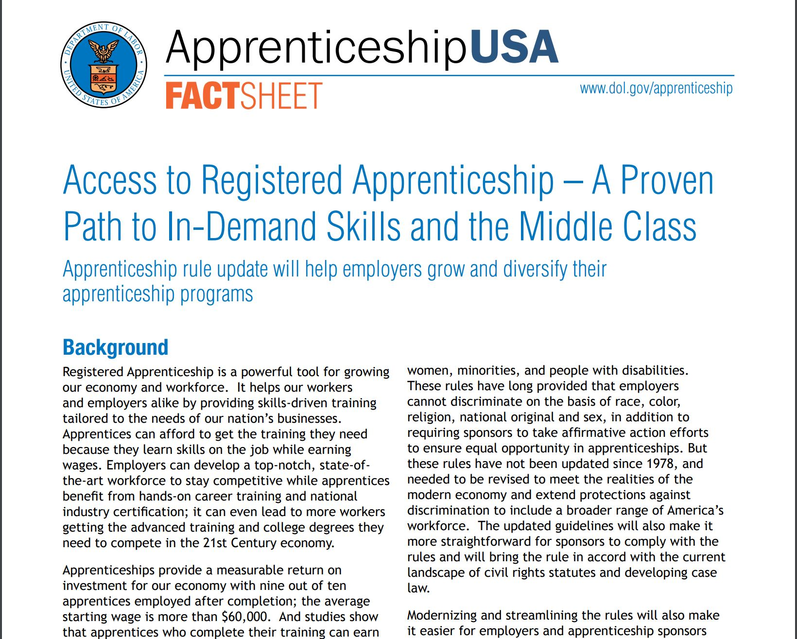
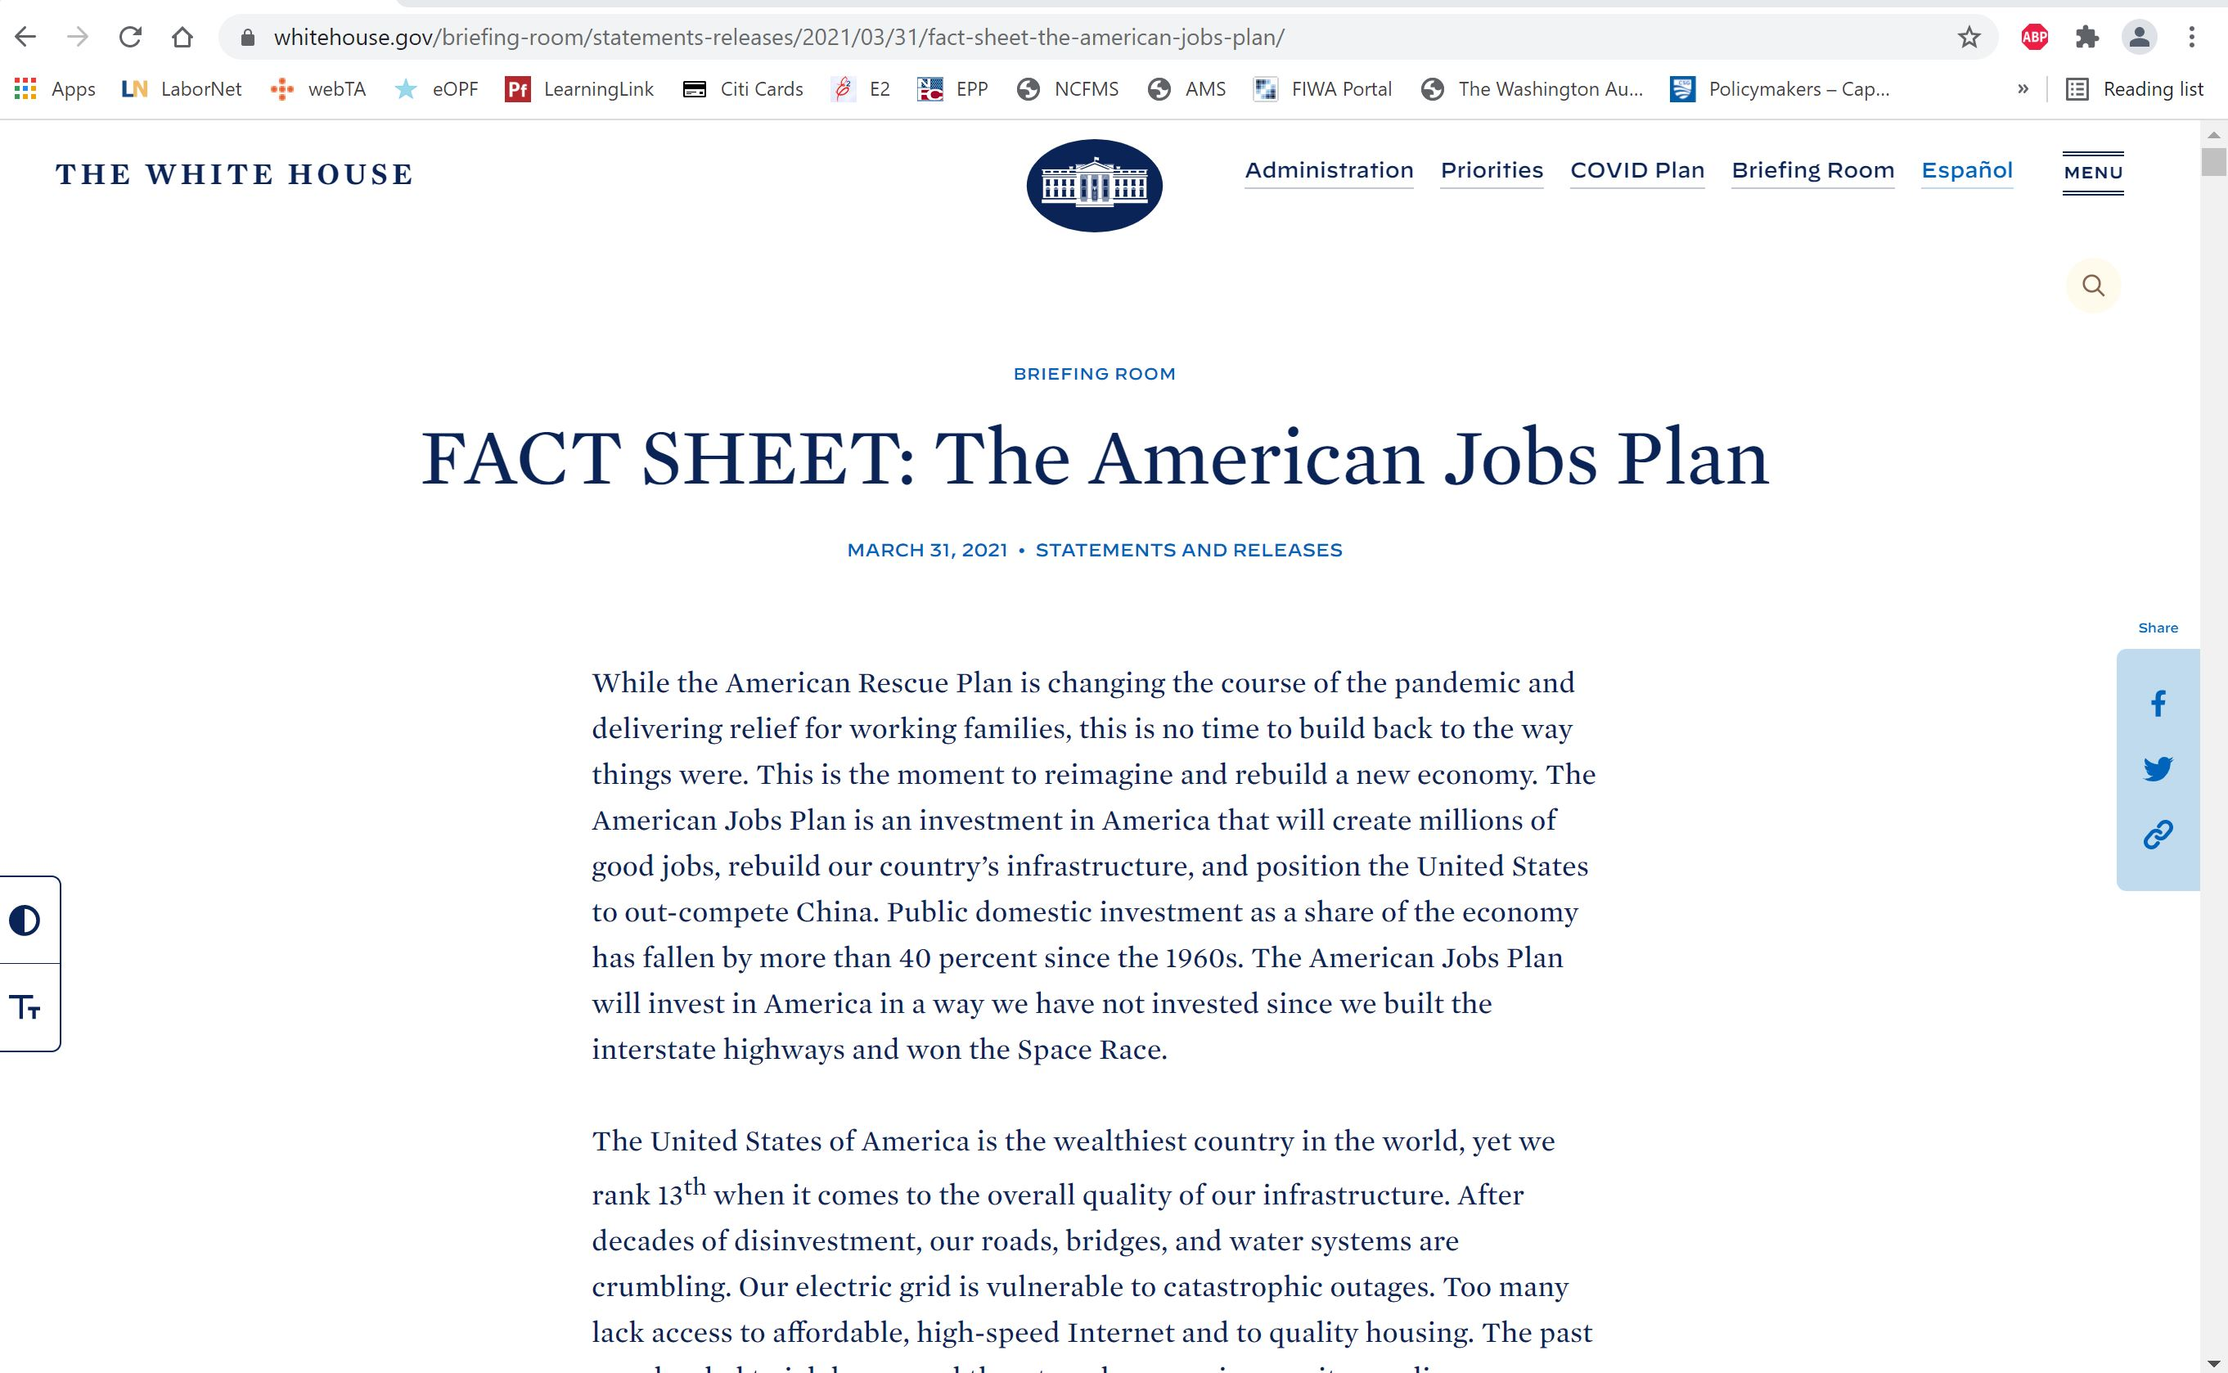
Core Policy Priorities Fuel Engagement on Apprenticeships
EO 13985 on Advancing Racial Equity and Support for Underserved Communities through the Federal Workforce
EO 14035 on Diversity, Equity, Inclusion, and Accessibility in the Federal Workforce
American Jobs Plan
Rehabilitation Act Section 503 and affirmative action for federal contractors
2016 Equal Employment Opportunity Rule on Apprenticeships
Goal of 7% for apprentices with disabilities in Registered Apprenticeship programs
Fact Sheet on Access to Registered Apprenticeship: A Proven Path to In-Demand Skills and the Middle Class
EO 14045 on Advancing Educational Equity, Excellence, and Economic Opportunity for Hispanics

Slide 9
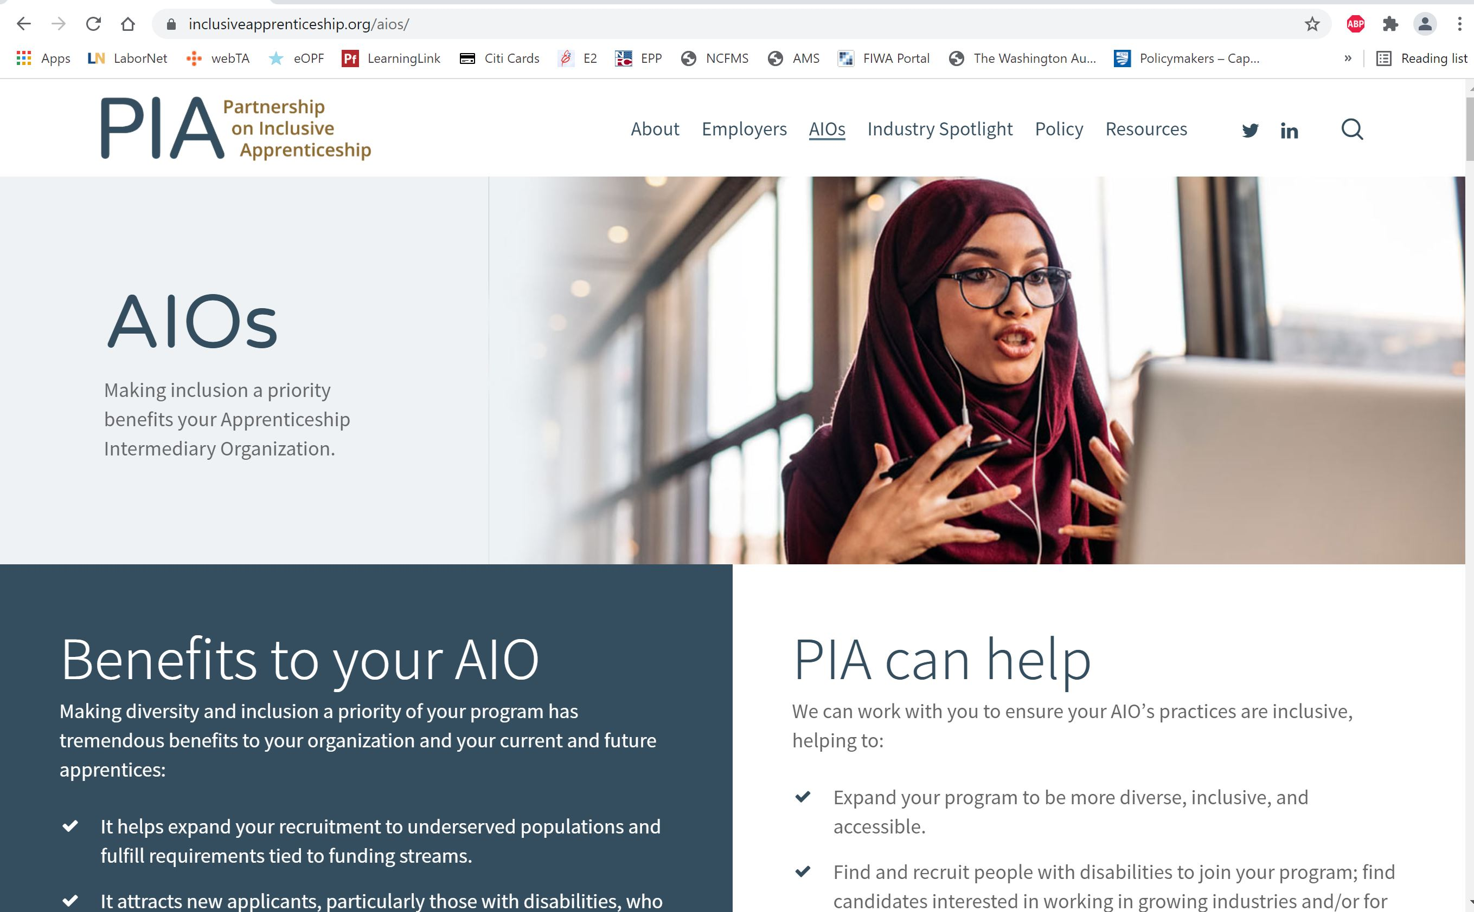

PIA Builds Partnerships with Apprenticeship Intermediaries
Apprenti (Washington Technology Industry Association)
Healthcare Career Advancement Program (H-CAP)
Three Talents
Cybersecurity Center for Business
SHRM Foundation
clean energy industry

Slide 10
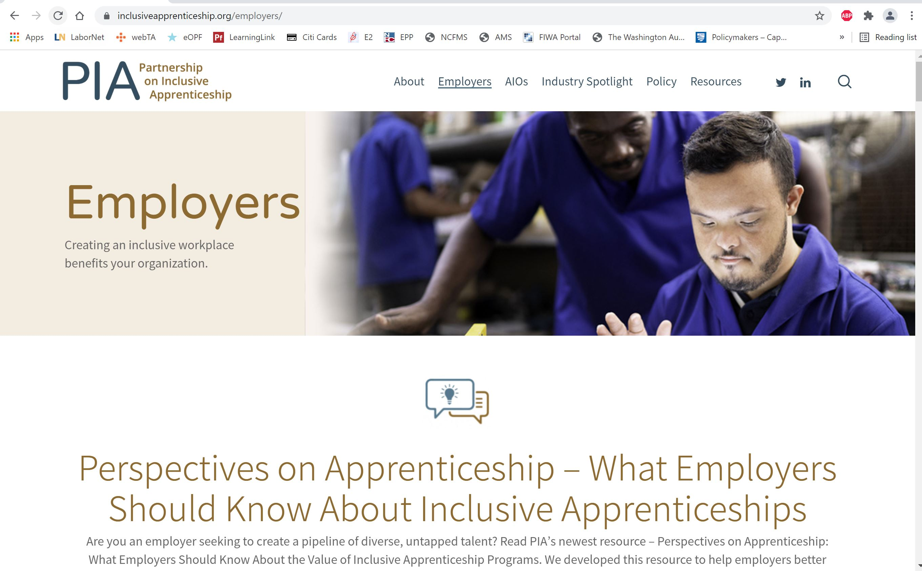
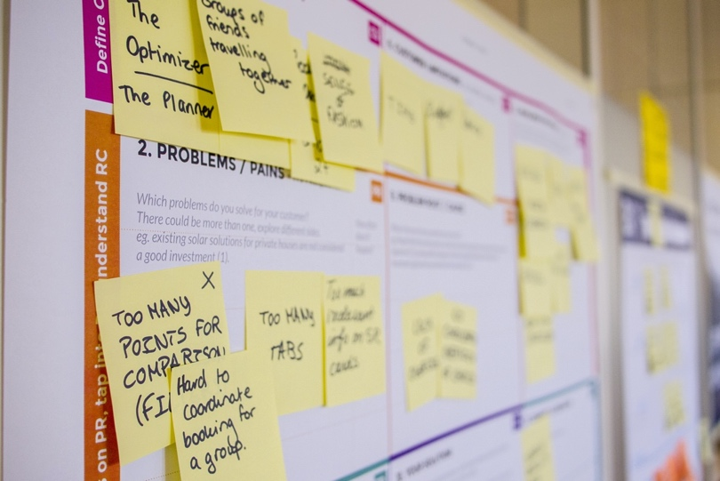
PIA Collaborates with Employers and Business Associations
Emphasis on inclusive workplaces and business benefits of inclusive apprenticeships
Inclusive talent pipelines for skilled, talented workers to address the skills gap
Return on investment from fostering inclusive apprenticeships
Approaches for enhancing efforts to recruit, hire, retain, and advance apprentices with disabilities and provide needed accommodations and supports
Daria Nepriakhina/Unsplash

Slide 11

PIA Provides These Resources on Apprenticeships
Apprenticeship for All Podcast series (8 episodes and growing)
Designing Inclusive Apprenticeships Guide
Perspectives on Inclusive Apprenticeships resource
Value of Inclusive Apprenticeships resource
Industry Spotlight
Clean energy sector
Natl. Clean Energy Week
Resource Library and Glossary
Resource webpages for employers, AIOs (intermediaries), and policymakers

Slide 12
Contact the Presenters
Scott Michael Robertson, PhD
robertson.scott.m@dol.gov
Josh Christianson
josh.christianson@wheelhousegroup.com

Slide 13

Thank you. Questions?
Photo by Johannes Plenio on Unsplash

